Slide 1

Univariate Analysis Visualization
Sili Fan WCMC statistician

Slide 2
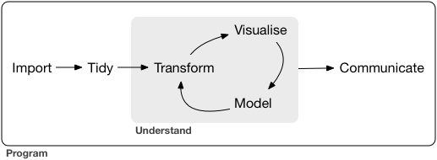
Study Objective
Software
Visualization by Design
Visualization by Charts
http://r4ds.had.co.nz/introduction.html

Slide 3
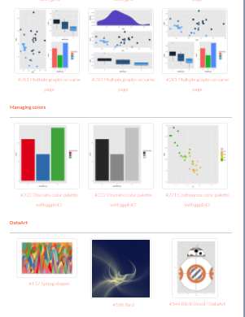
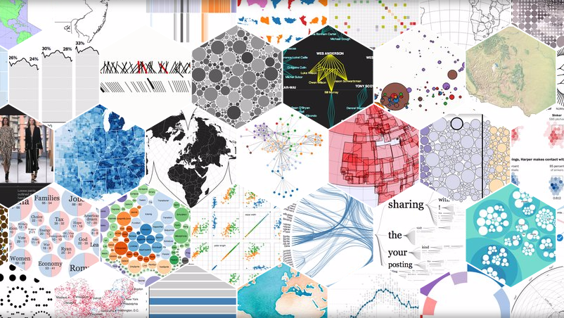
Visualization
Software/ Packages
Almost all the statistical analysis tools provide data visualization
Standardization + Flexibility + Publishability
Free Online: Metabox, Metaboanalyst, BoxPlotR
Commercial: SIMCA, SPSS, Stata
Computing language R package: ggplot2, ReporteRs
Computing language JS library: D3.js
Commercial: Tableau, plotly
Computing language R package: ggsci, pubr, ggpubr
D3.js
ggplot2

Slide 4
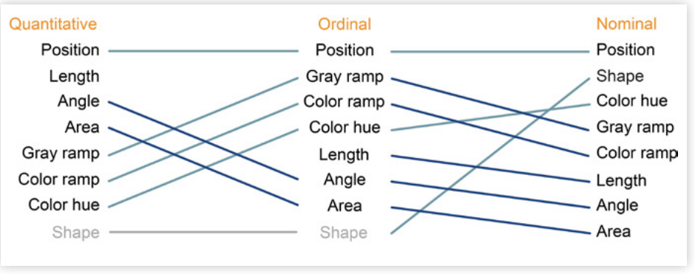
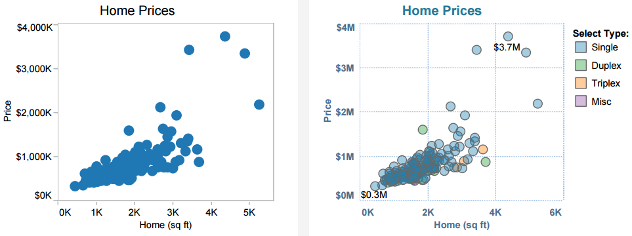
Visualization by Design
Different Data Type, Different View
Intensity
p-value
Correlation coefficient
Fold-change
etc.
Injection Order
Disease Severity
Performance Evaluation
Repeated measure
etc.
Gender
Race
Species
Treatments
etc.
Good
Great!

Slide 5
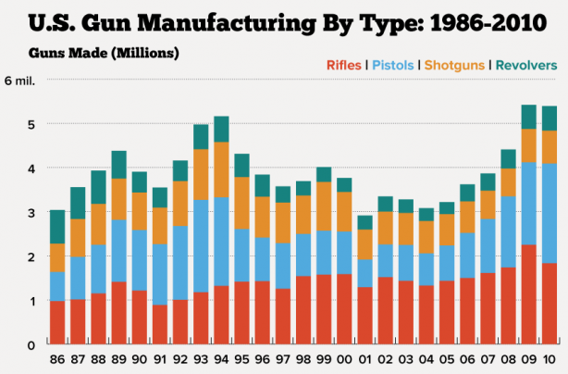
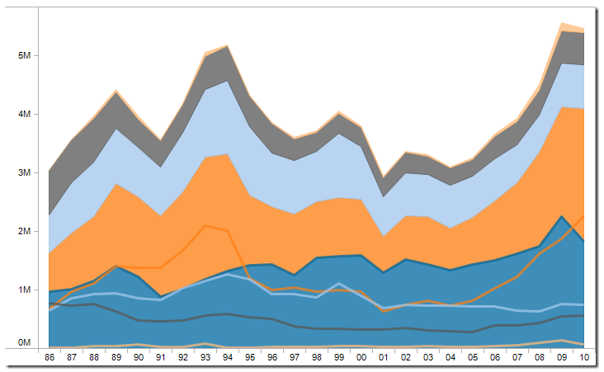
Visualization by Design
Different Objective, Different View
Trends over time
line charts, area charts, and bar charts. In addition, you should try to put time on the X-axis and the measure on the Y-axis.
Example: time-series
http://www.vizwiz.com/2012/08/displaying-time-series-data-stacked.html

Slide 6
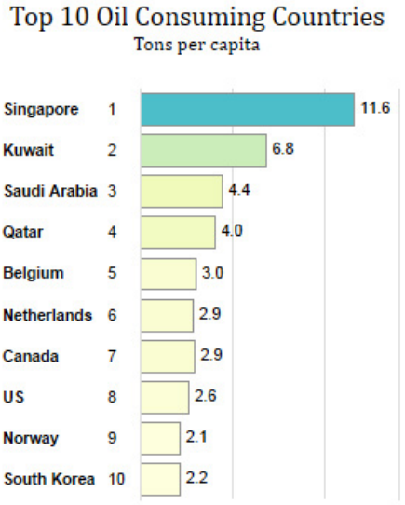
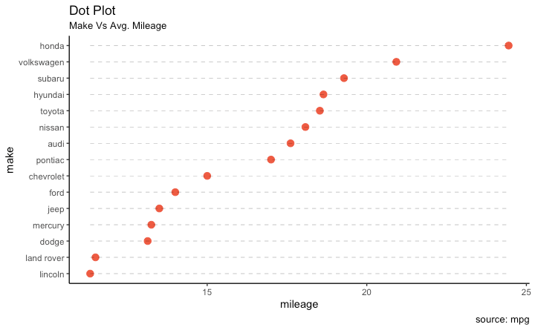
Visualization by Design
Different Objective, Different View
2. Comparison/ranking
Horizontal bar charts encodes quantitative values as length on the same baseline, making it extremely easy to compare values
Example: VIP score
http://r-statistics.co/Top50-Ggplot2-Visualizations-MasterList-R-Code.html

Slide 7
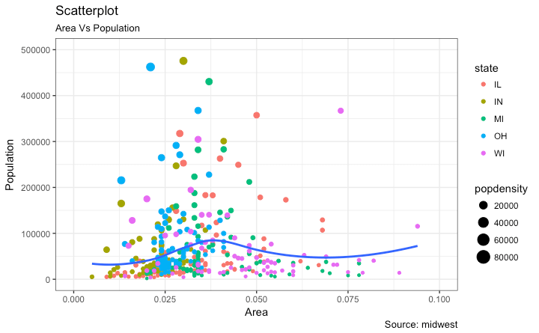
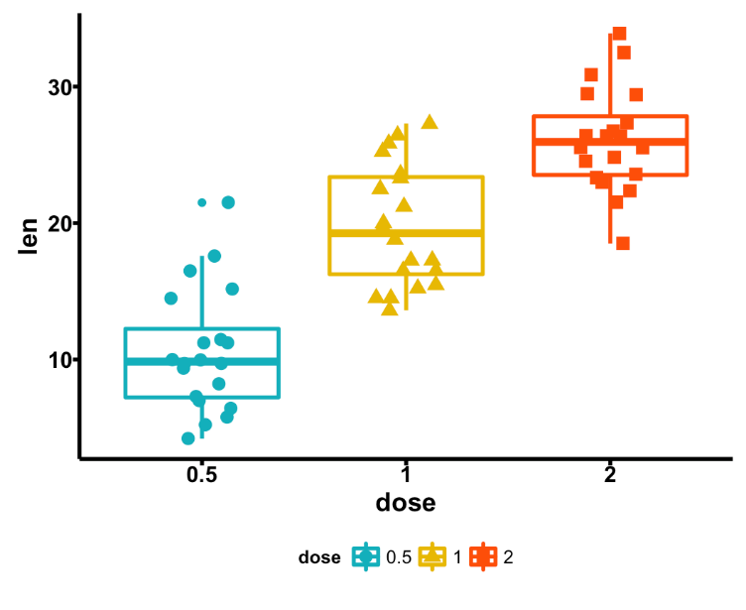
Visualization by Design
Different Objective, Different View
3. Correlation
Scatter plot, boxplot, bar charts, etc.
Example: compound intensity
http://r-statistics.co/Top50-Ggplot2-Visualizations-MasterList-R-Code.html

Slide 8
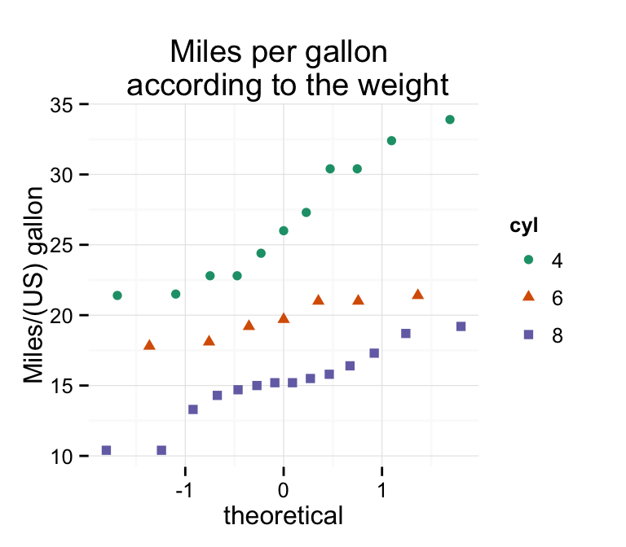
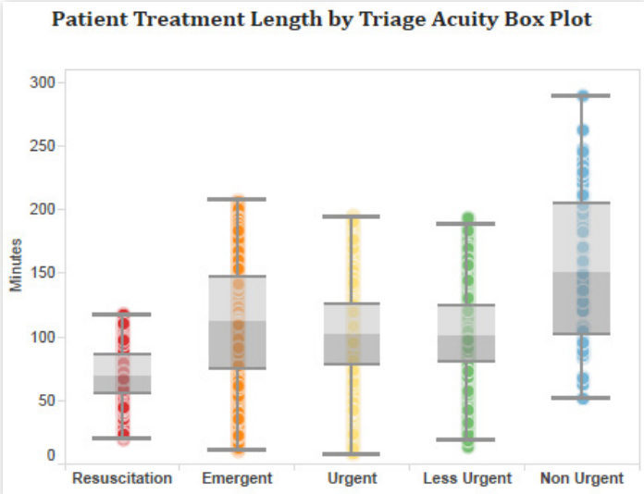
Visualization by Design
Different Objective, Different View
4. Distribution
boxplot, frequency histogram, density plot, QQ-plot
Example: normality examination
http://www.sthda.com/english/wiki/ggplot2-qq-plot-quantile-quantile-graph-quick-start-guide-r-software-and-data-visualization

Slide 9
Visualization by Design
Different Objective, Different View
4. Distribution
boxplot, frequency histogram, density plot, QQ-plot
Example: normality examination
http://www.sthda.com/english/wiki/ggplot2-qq-plot-quantile-quantile-graph-quick-start-guide-r-software-and-data-visualization

Slide 10
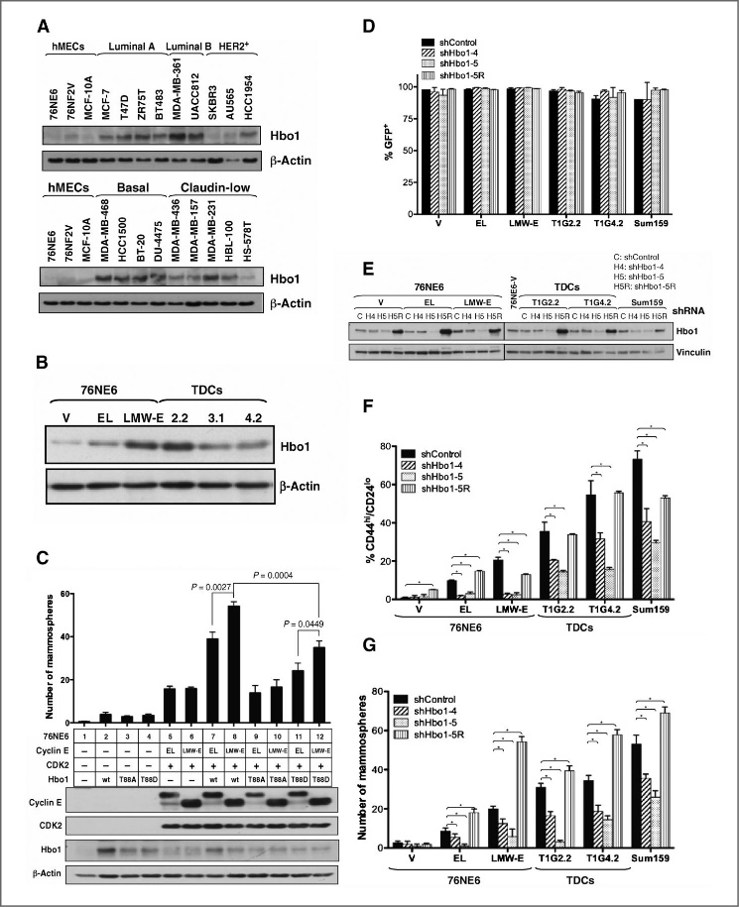
Visualization by Charts
Bar Chart: quick comparison, revealing highs and lows at a glance
Comparing data across category
Useful when comparing averages
Consider
Add color to bars for more impact
Use side-by-side bars or stacked bars
Flip the axis (horizontal bar)
Bar chart
http://cancerres.aacrjournals.org/content/73/17/5556

Slide 11
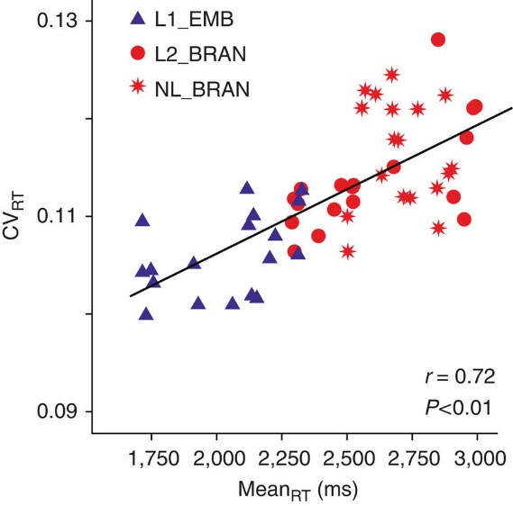
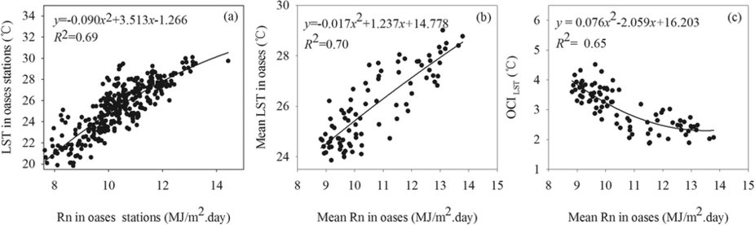
Visualization by Charts
Scatter Plots: give you a sense of trends, concentrations, outliers, etc
Investigating relationship between variables
Useful when visualizing effects over time
Consider
Add trend line and statistics to explain relationship
Use informative mark types
Scatter Plot
https://www.nature.com/articles/ncomms3041/figures/1

Slide 12
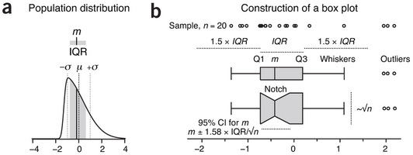
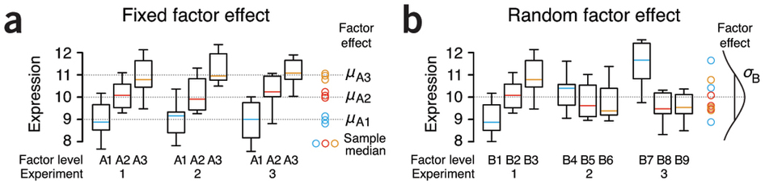
Visualization by Charts
Box-and-whisker plot: show distribution, outlier of the data
Investigating distribution and examine data assumption
Useful for comparing distributions across groups
whiskers
Skewness
Notch: 95% confidence interval for the mean (or median).
Box Plot
https://www.nature.com/nmeth/journal/v11/n2/full/nmeth.2813.html

Slide 13
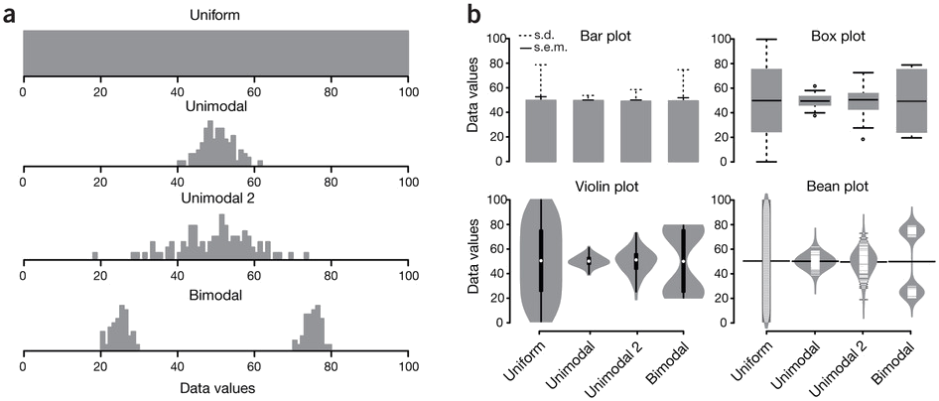
Visualization by Charts
Histogram vs. Boxplot (and its variations) vs. bar chart
Box plot
Bar plot is for showing the mean, s.d. and s.e.m.
Histogram, Violin plot and bean plot represent the detailed distribution.
Box plot represent the summary of distribution.
https://www.nature.com/nmeth/journal/v11/n2/full/nmeth.2811.html

Slide 14
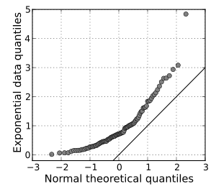
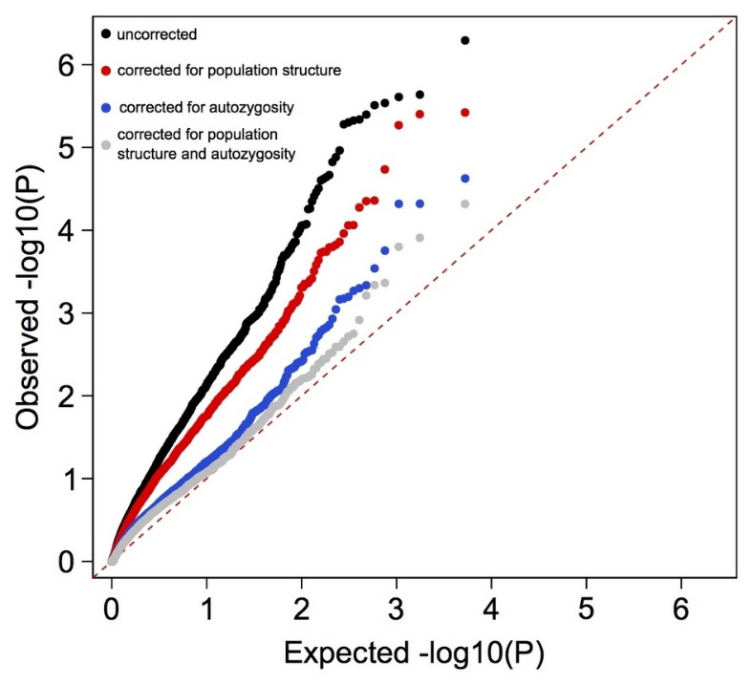
Visualization by Charts
QQ-plot: quantile-quantile plot
Investigating similarity between two distributions
Useful for examine the normality
Useful for examine the distribution of p-value
QQ plot
https://en.wikipedia.org/wiki/Q%E2%80%93Q_plot
http://www.nature.com/ng/journal/v47/n11/fig_tab/ng.3410_SF4.html

Slide 15
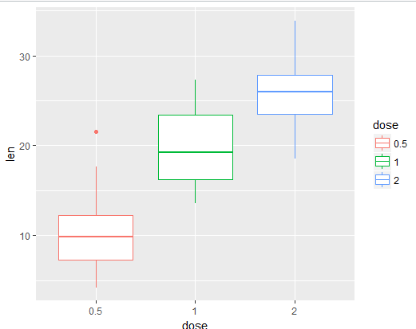
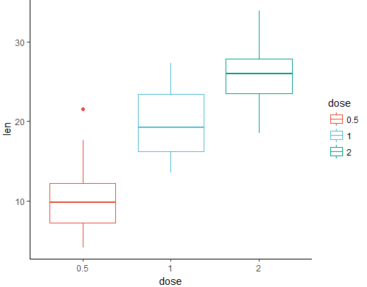
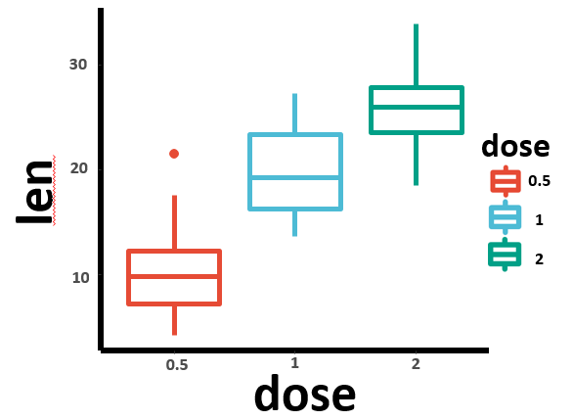
Publishable Plot
ggplot2 + ggsci + ReporteRs
ggplot2: the most famous data visualization R package to generate the frame of plot
ggsci: offers collection of color palettes for scientific journals
ReporteRs: provide more flexibility for customization
Publication
ggplot2
ggsci
ReporteRs
basic plot frame
journal color scheme
(nature)
manual adjustment
Axis title, label, legend, etc. should be large enough for the print of journals

Slide 16
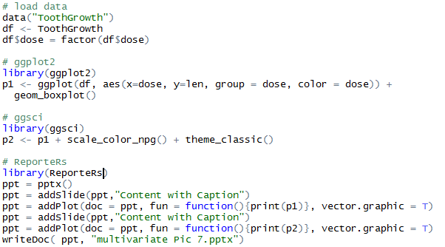
Publishable Plot
ggplot2 + ggsci + ReporteRs
ggplot2
ggsci
ReporteRs
basic plot frame
journal color scheme
manual adjustment
Publication

Slide 17
Understand visualization objective
Decide chart type
Add some information on the Chart
Publishable looking
Visit useful Visualization Websites, e.g. D3.js, Echarts.js, ggplot2 gallery, etc.
Conclusion remarks

